Slide 1
An Empirical Investigation of the Impact of Monetary Policy on the Economic Activity of Wyoming State
Ryan Minghao Zhao

Slide 2


Philips’ Curve and Fisher Eq.

Slide 3
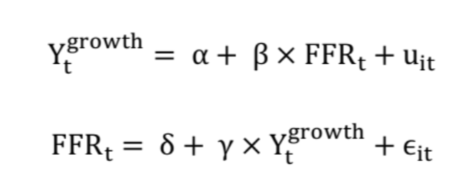
Empirical Challenges
Endogeneity
This problem occurs when there is a simultaneous relationship between the two variables.
Simply regressing growth rate against Federal Funds Rate (FFR) will bias the slope coefficient beta.

Slide 4
Data origin — Wyoming State
Our data comes from the FRED
Raw real GDP (quarterly)
Unemployment rate (monthly)
Federal Funds Rate i.e. FFR (monthly)
Using R, we converted the monthly data into quarterly data.
Computed the real GDP growth rate using the raw GDP data
Restricted the time period to 1997 to 2022

Slide 5
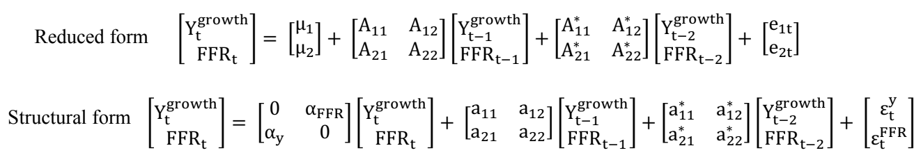
Main Econometric Model
Vector Autoregression (VAR)
By estimating the 2 equations simultaneously in VAR, the endogeneity problem was resolved.
Using the VAR.select function in R, we selected the order for VAR as 2.
We start by estimating the reduced form, then we can estimate the parameters in the structural form and compute the structural impulse response function.

Slide 6
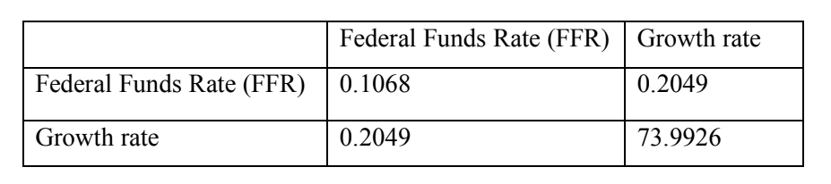
Key Empirical Results
The covariance between GDP growth rate and Federal Funds Rate is positive.
So there is a positive contemporaneous relation between the two variables
Is this causality???

Slide 7
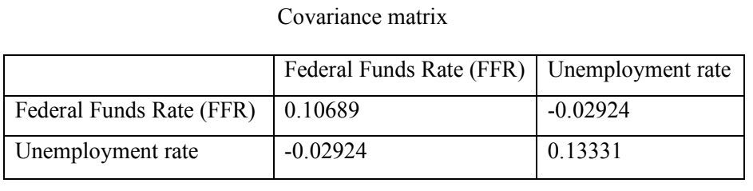
Key Empirical Results
The covariance between Unemployment rate and Federal Funds Rate is negative.
So there is a negative contemporaneous relation between the two variables
Is this causality???

Slide 8
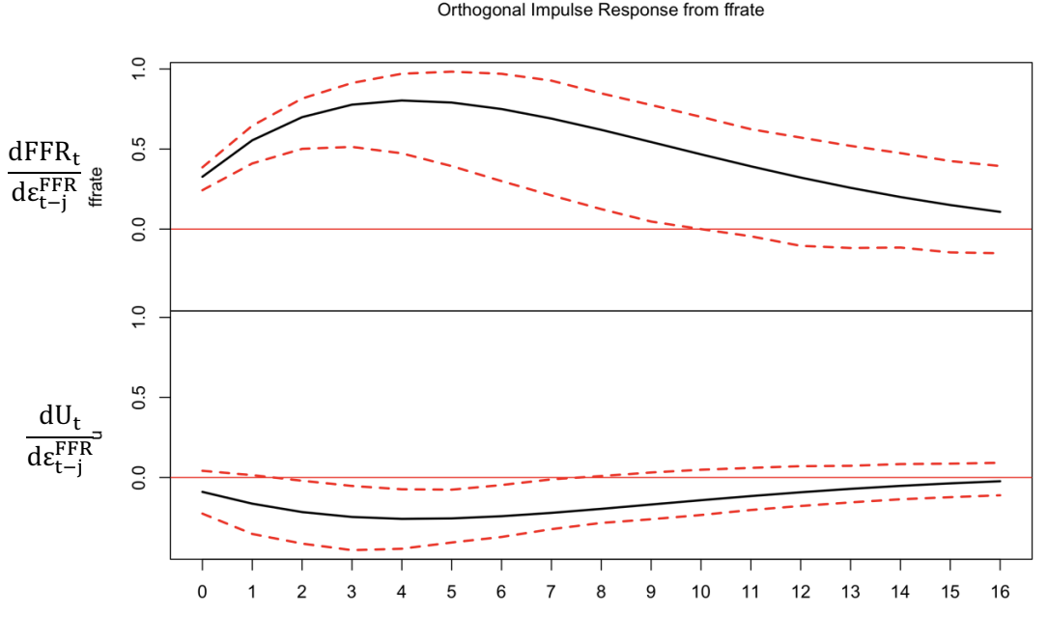
Cont., Impulse response function analysis

Slide 9
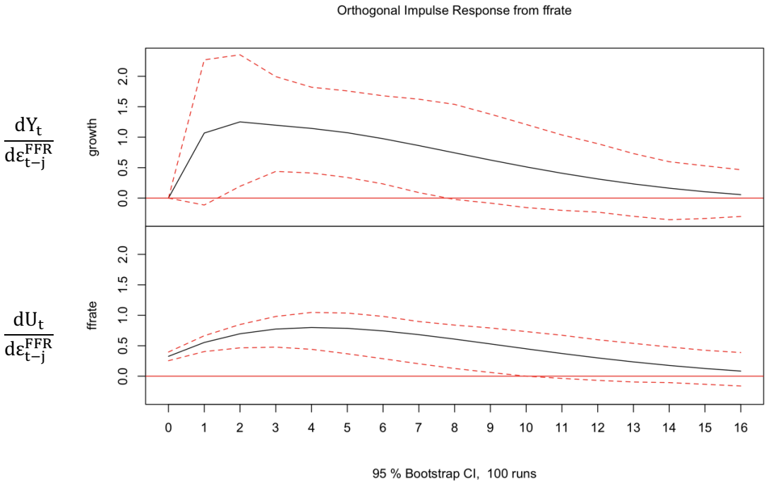
Cont., Impulse response function analysis

Slide 10
Conclusion
A shock in Federal Funds rate has a negative causal effect (-0.1 to -0.3 change) on unemployment rate
A shock in Federal Funds rate has a positive causal effect (+0.5 to 1 change) on GDP growth rate.
The effect only takes place if the shock occurs within two to seven lags of the current real GDP/ unemployment rate.

Slide 11
Limitations of our study
In terms of internal validity, since we did not take the data being non-stationary into consideration, we might end up with spurious regression → complete nonsense.
The results we obtained from Wyoming’s data might not be conclusive to the other states or the entire USA.
The economic sector composure varies between different state, some are more sensitive to FFR while some are not so we might get different conclusions if we do the same analysis to other states

Slide 12
End

